Slide 1
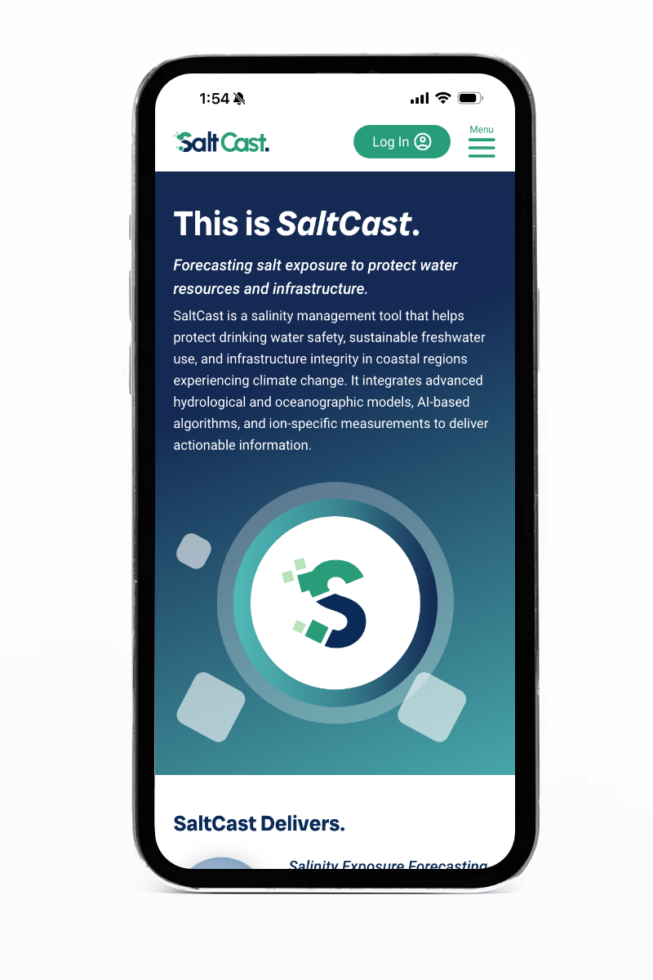

Forecasting salt exposure for water security and infrastructure integrity.

Slide 2
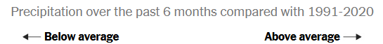
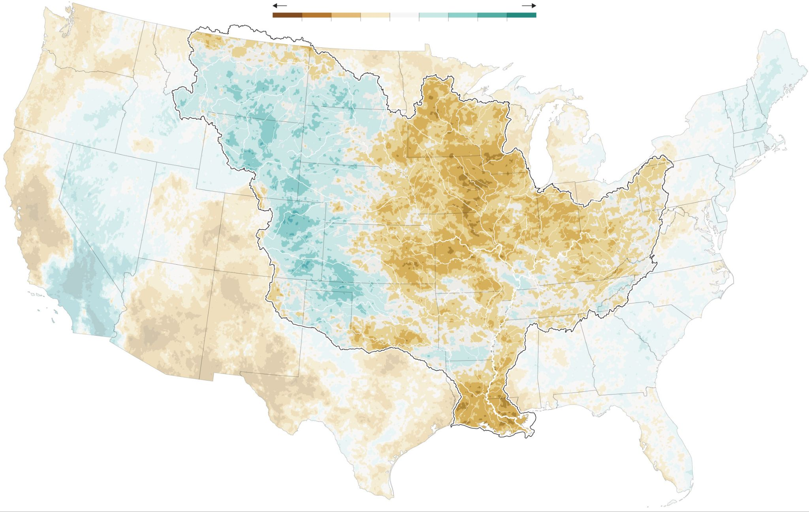
Drought
Reduces Flow
Down the
Mississippi River
Source: New York Times (Sep. 2023)
Notes:
Source: https://www.nytimes.com/interactive/2023/09/29/climate/new-orleans-saltwater-map.html

Slide 3
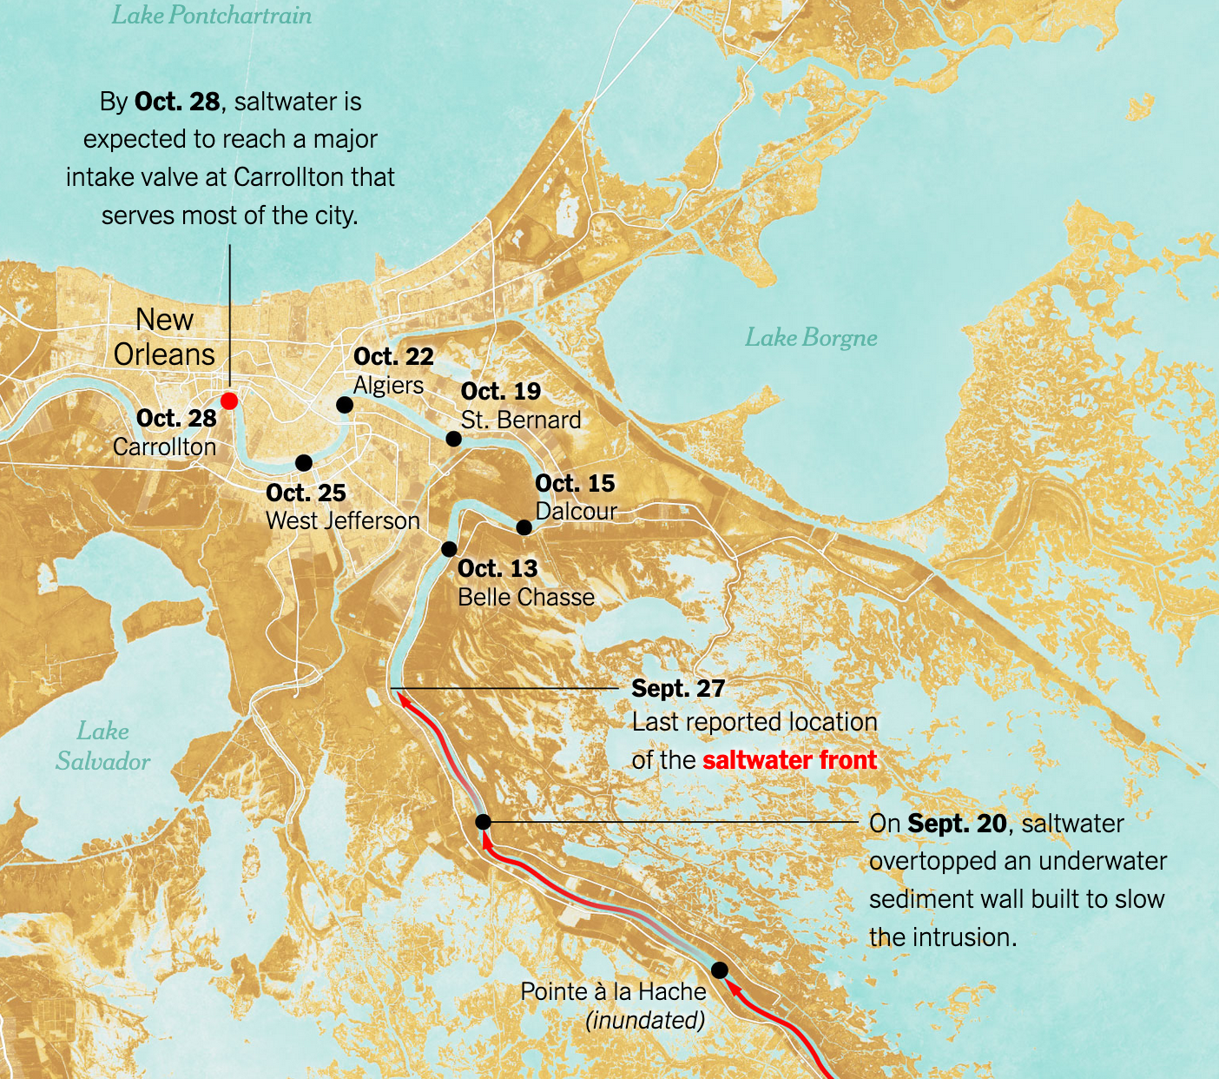
Reduced Flow
Leads to
Saltwater Intrusion
Source: New York Times (Sep. 2023)
Notes:
Source: https://www.nytimes.com/interactive/2023/09/29/climate/new-orleans-saltwater-map.html

Slide 4

Notes:
In a changing climate with rapid sea level rise and extended drought, saltwater intrusion is affecting many tidal rivers, including the Hudson River and New York City, the Delaware River and Philadelphia, and San Francisco Bay-Delta on the west coast. It is also affecting tidal rivers and cities in Europe, Asia, South America and Africa, making headline news around the world. Another place this will be a problem is the MAR…20% of US populations lives in mid-Atlantic region all served from tidal regions. Documented salinization impacts on all rivers.

Slide 5
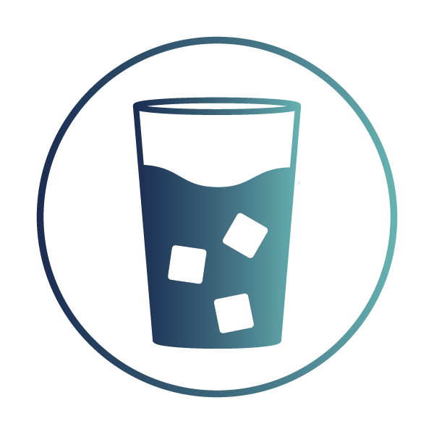





Why Does Salt Matter?
Taste
Public Health
Infrastructure Corrosion
Ecosystem Health
Agricultural Impacts
Costs
Notes:
More on secondary effects. Information on watershed hydrology, estuary model, informing adaptation outcomes

Slide 6
Salinity Exposure Will Be Expensive
In the mid-Atlantic region, costs related to increasing salinity in farmland are expected to reach up to $100 million per year (source: Model et al, 2023, Nature Sustainability)
Nationally, over a trillion dollars in infrastructure investment needed in U.S. drinking and wastewater systems (source: EPA, 2023).
No existing data on the full costs of salinity exposure across U.S. coasts. Because salinity will impact freshwater provision, infrastructure, ecosystems, and agriculture — adaptation could stretch into trillions of dollars

Slide 7
Phase I: User Pain Points
"I am very worried about the corrosiveness of salt inside my treatment processes…
We are very concerned with corrosiveness in the soil. I have my transmission pipes that come from this plant. We installed it in ’04, ‘05, ‘06 and I've already had external corrosion leaks in about 8 of them on that piping system."
— Small water supplier near Chesapeake Bay

Slide 8
Phase I: User Pain Points
"Any changes cannot happen overnight and are expensive. We need a way to predict salinity and corrosion problems."
— Large water supplier near Chesapeake Bay

Slide 9
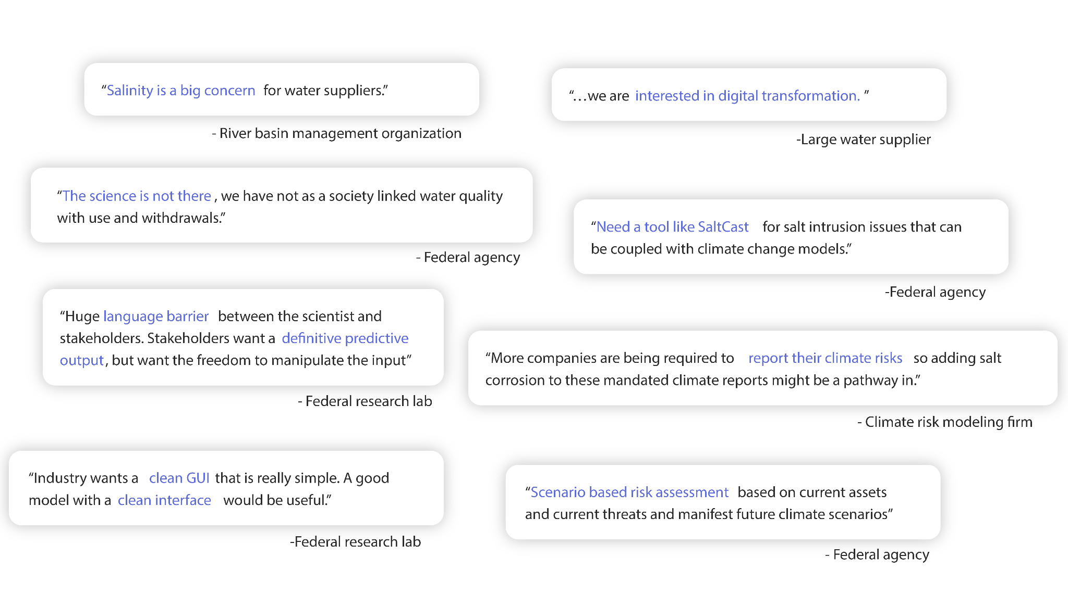
Phase I: Talked to Over 40 Prospective SaltCast Users
Notes:
Users re-iterate that salt is a big concern, the science isn’t there, they’re interested in using digital tools, and they need outputs like a GUI that meets their needs. But, often they didn’t know what to do.

Slide 10


But … What Is In Salt?
Salt comprises many ions, including:
Sodium
Chloride
Calcium
Magnesium
Sulfate
Each ion has different consequences and informs different management strategies
Notes:
This is the problem. This is a terrible problem. Replace with headlines slide (Ming)

Slide 11
What Are Salinity Management Strategies?
Reduce salt exposure
Release freshwater strategically from inland reservoirs
Manage winter road de-icer applications
Coordinate and time withdrawals across users
Manage corrosion
Apply corrosion inhibitors
Select corrosion-resistant infrastructure materials
Avoid salt
Move water intakes
Build new infrastructure -- interconnections, desalination
Notes:
Information on watershed hydrology, estuary model, informing adaptation outcomes

Slide 12
No Existing Tools Provide Salinity Forecasts
No tools provide salinity forecasts in river basins and tidal rivers
No ion-specific models in tidal rivers and estuaries
No integration of weather and climate forecasts
No integration with salinity management options
Notes:
Information on watershed hydrology, estuary model, informing adaptation outcomes. Composition matters. (reinforcement learning, evolutionary optimization)

Slide 13
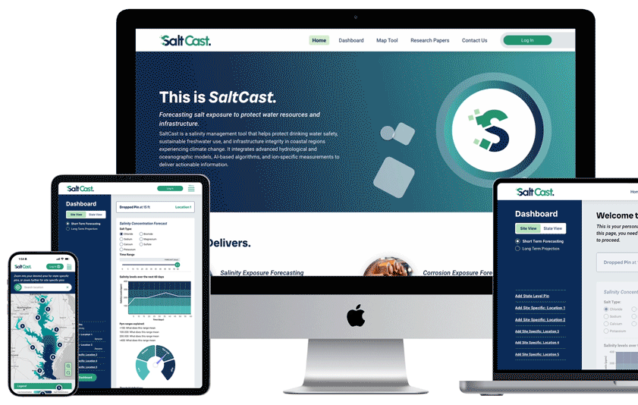
SaltCast Delivers…
Coupled watershed-estuary model
Ion-specific forecasts
Seamless short-term and long-term forecasts from the next day to the next century
Adaptation playbook combines outputs from AI algorithms with qualitative, case study research

Slide 14
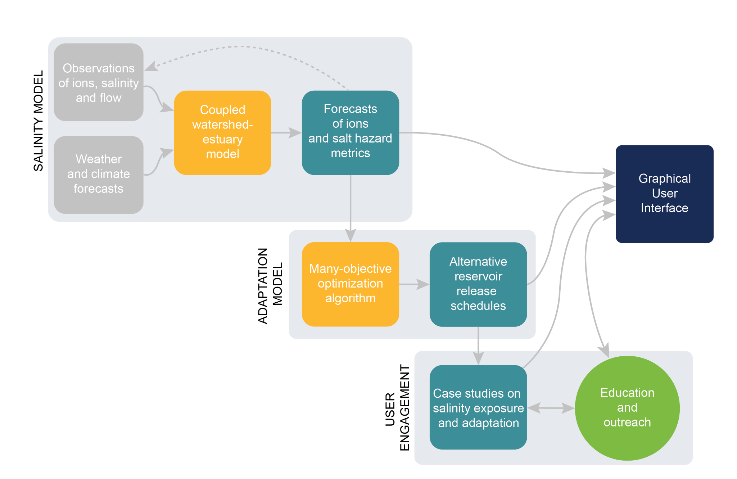
SaltCast Decision Support System

Slide 15
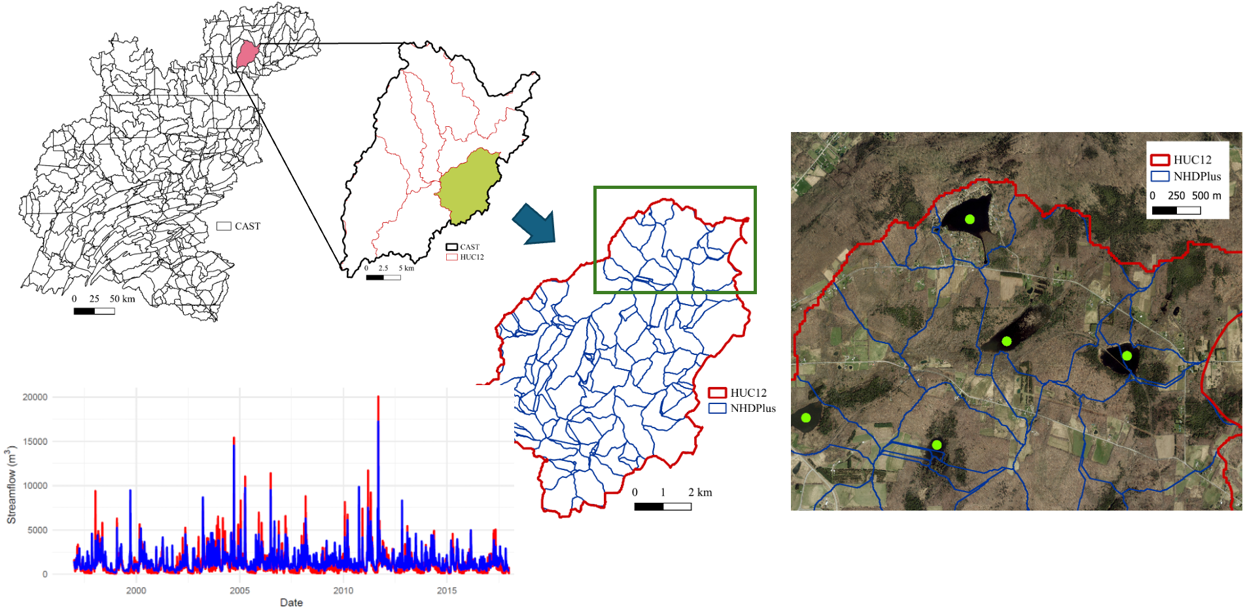
Soil and Water Assessment Tool (SWAT+) Watershed Model
Model evaluation
Notes:
The hydrological model simulates streamflow and salt concentration at a high spatial resolution, incorporating landscape and water management practices and road salts.

Slide 16
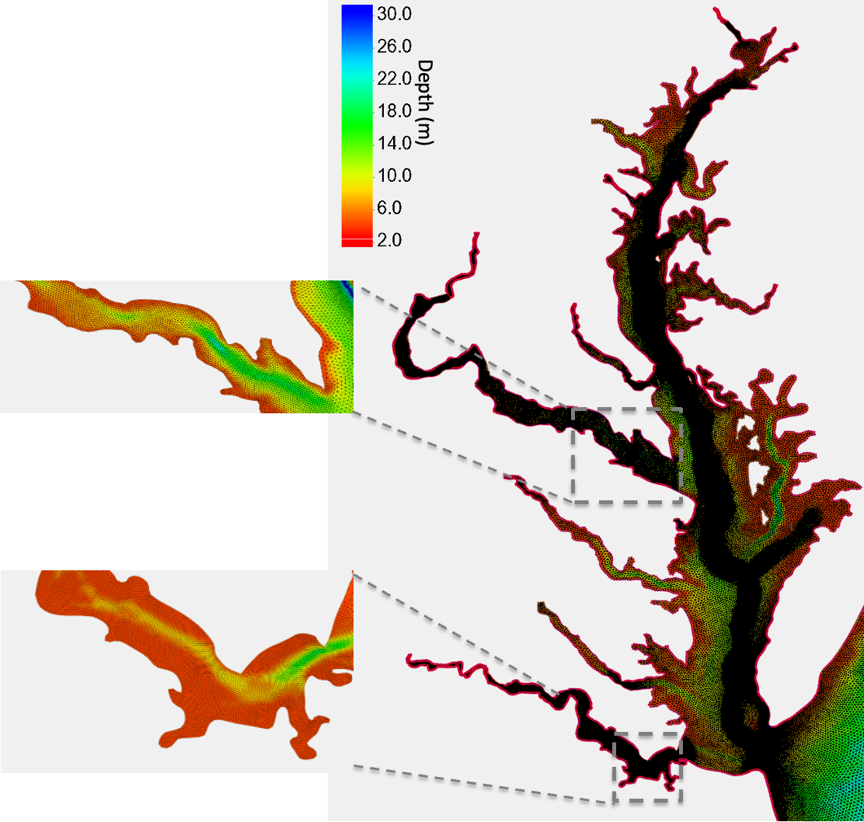
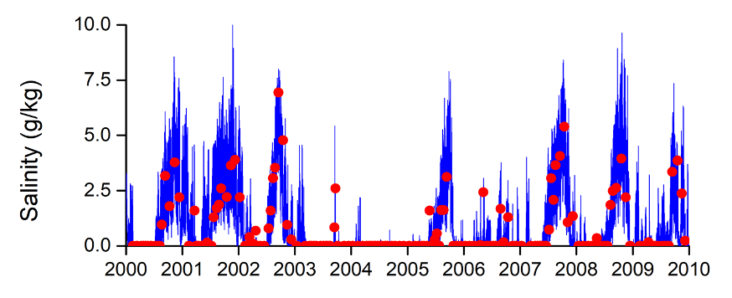

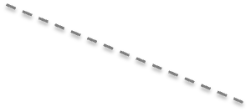
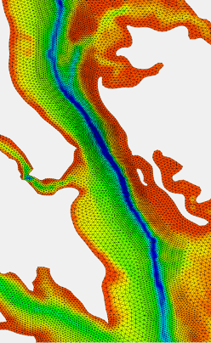
Finite Volume Coastal Ocean Model (FVCOM)
Model evaluation
Potomac River
James River
Chesapeake Bay Main Channel
Notes:
The hydrodynamic model can predict salinity distribution in three dimensions with fine resolution in tidal rivers and will be extended to predict individual ion concentrations as well as the total salt level during phase II.

Slide 17
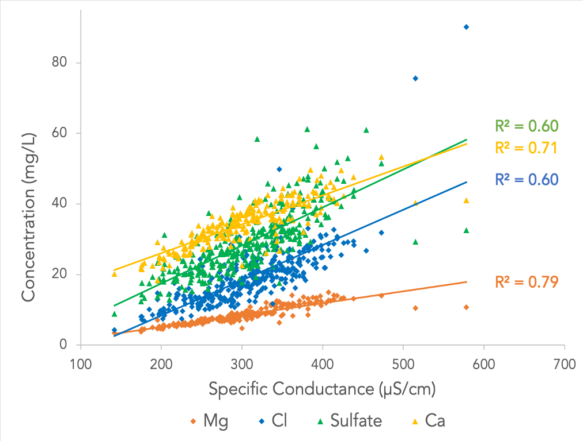
USGS monitoring station on the Potomac River
Site-Specific
Ion Composition
Notes:
Statistical models and relationships can be used to predict ion specific mixtures and also secondary effects of freshwater salinization on mobilization of nutrients and metals.

Slide 18
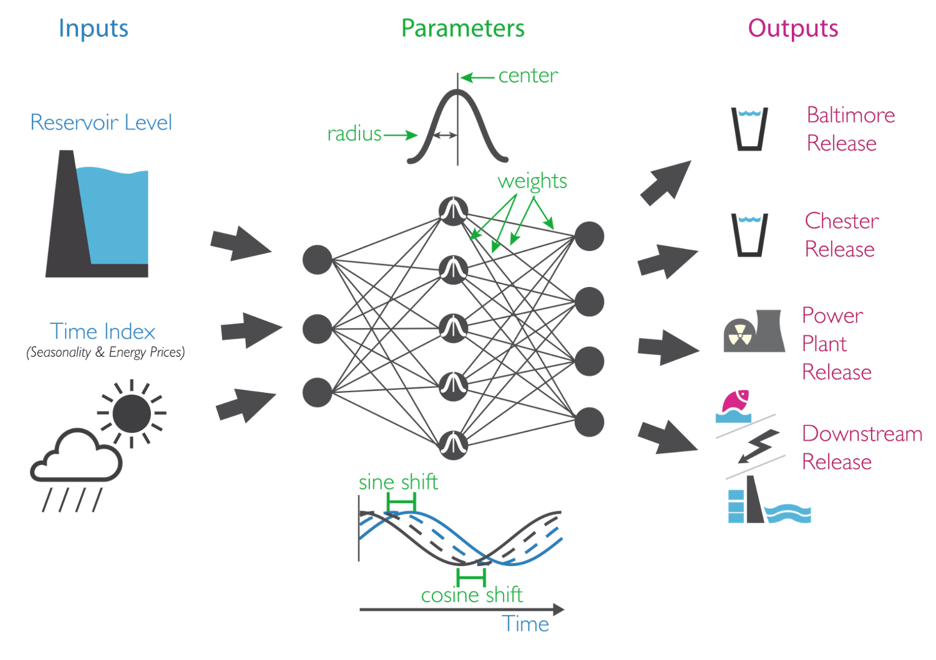
Search For
Alternative
Reservoir
Release
Schedules
Notes:
AI methods, like evolutionary optimization and reinforcement learning, can be used to train adaptive reservoir release schedules to dilute salinity in streams

Slide 19
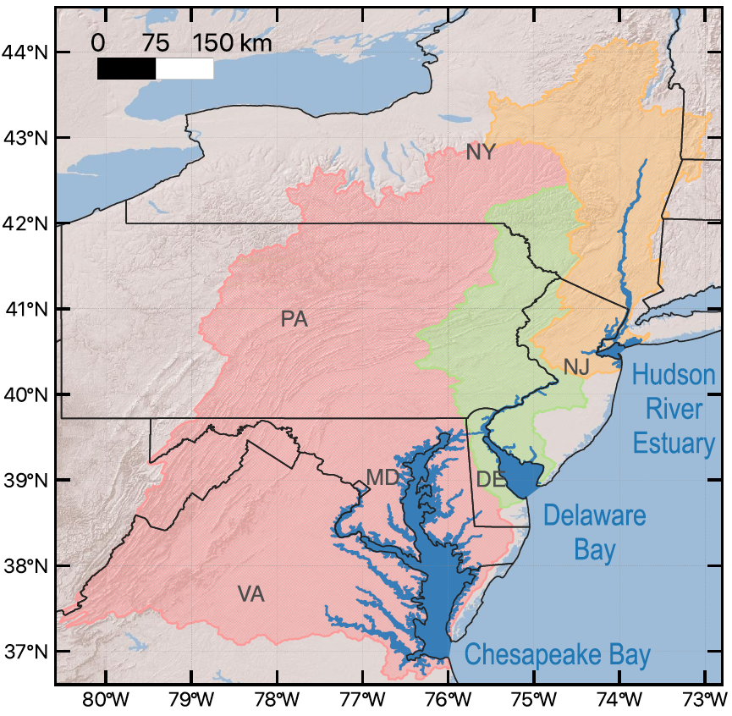
Phase I➡II: Expand to Mid-Atlantic Region
20% of the US population
Large, heavily utilized tidal rivers
Observed salinity increases in all major rivers
Higher-than-average sea-level rise
Notes:
Another place this will be a problem is the MAR…20% of US populations lives in mid-Atlantic region all served from tidal regions. Documented salinization impacts on all rivers.

Slide 20
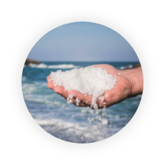

Phase I➡II: Expand Outputs in Response to Interviews
Salinity Exposure Forecasting
Forecasting salinity, specific conductance, chloride, and sodium at user-specified locations from hours to decades.
Corrosion Exposure Forecasting
Forecasting chloride to sulfate mass ratios, pH, alkalinity, and hardness trends from acute to chronic conditions.

Slide 21

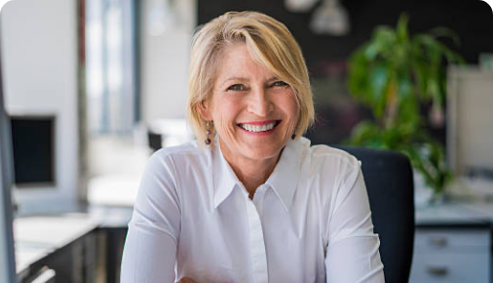

Phase I➡II: Interfaces for Different Needs
Target customers: Coastal freshwater users and infrastructure planners
Small water supplier
Simple interface
Alerts for short-term salinity spikes
Free
Learn about management strategies
State or regional agency
or large water supplier
Willing to use a new tool
Long-term projections
Learn about management strategies
Federal agency
Has existing tools, but sees gaps
Integrate long-term projections into their tools via API
Notes:
Discuss how user needs led to UX/UI. Initial hypotheses and what we learned instead. But at a high level. 3-5 bullets. First we thought it was drinking water suppliers, then corrosion, now broader.
Walter Water -- managing salt
Imelda Infrastructure -- water or land use permitting
Fred Federal

Slide 22
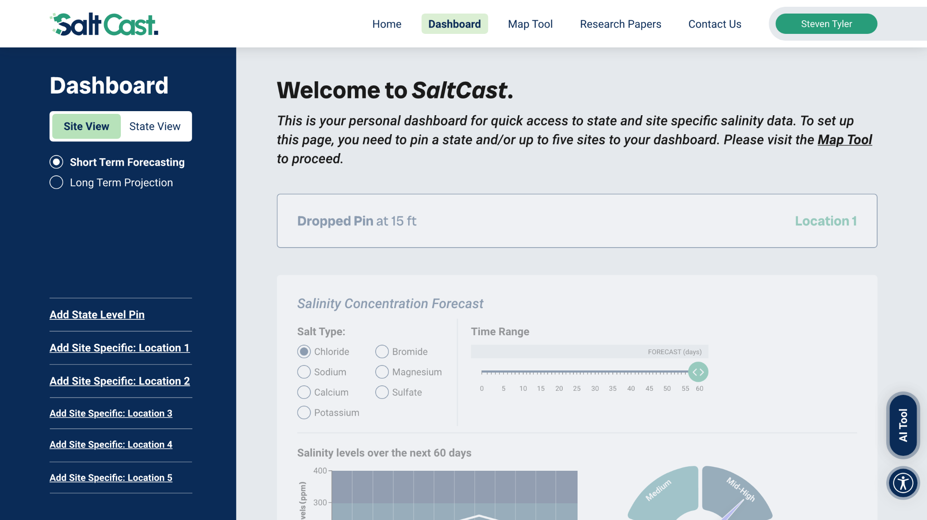

Slide 23
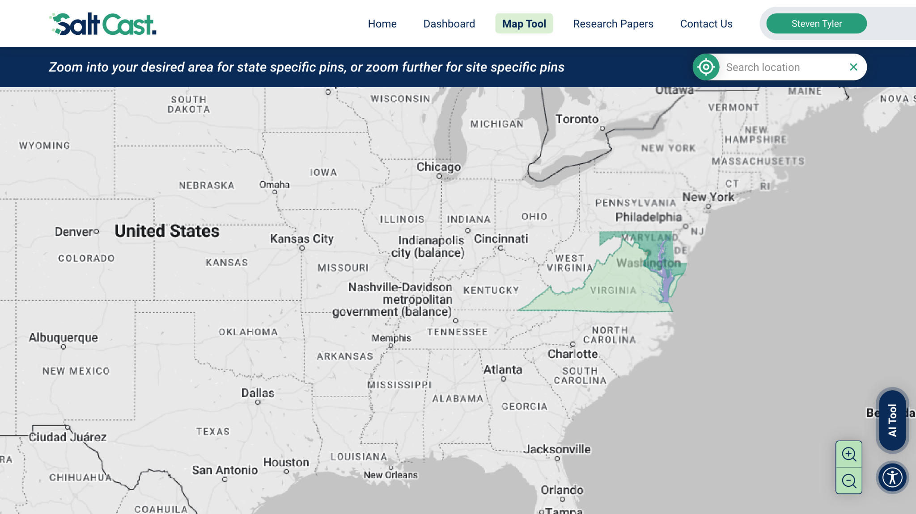

Slide 24
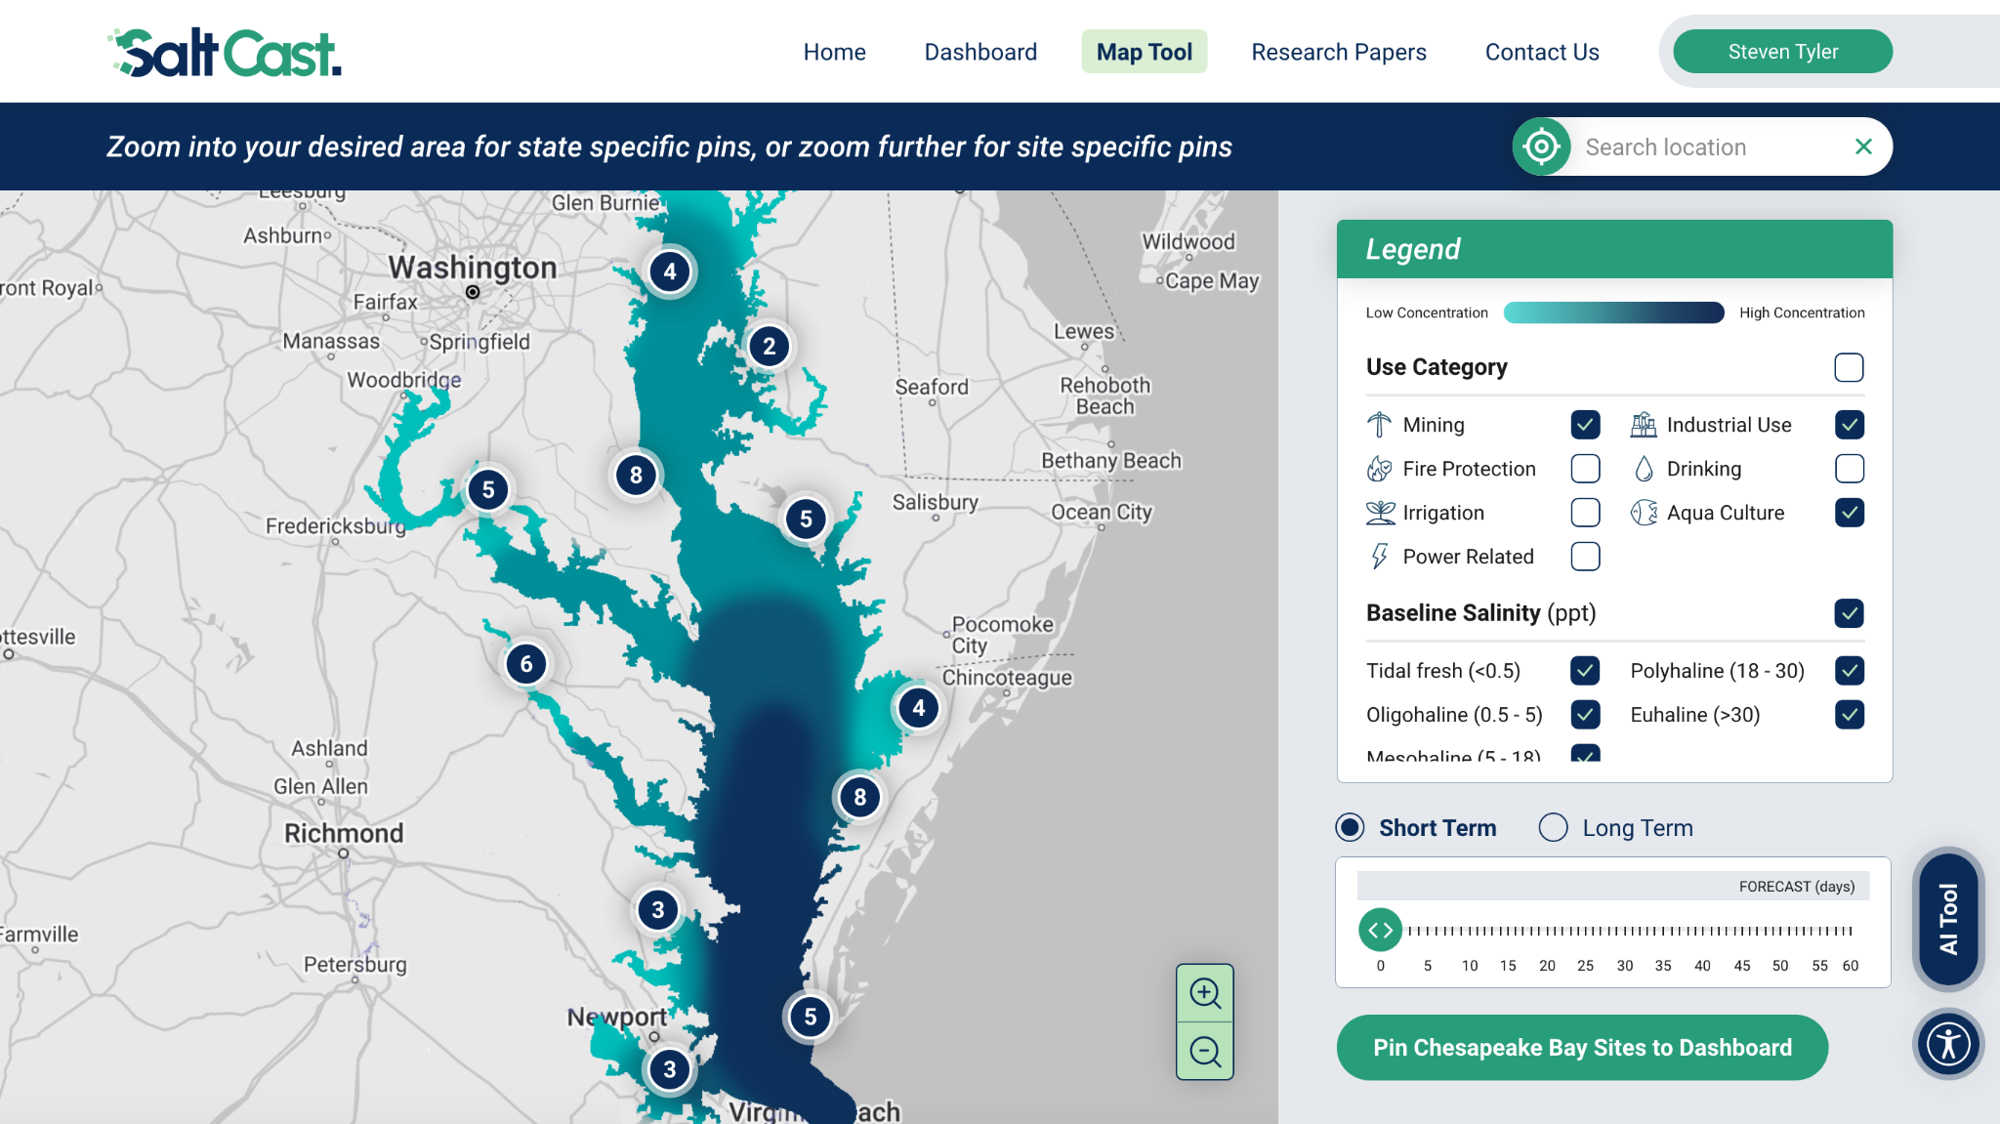

Slide 25
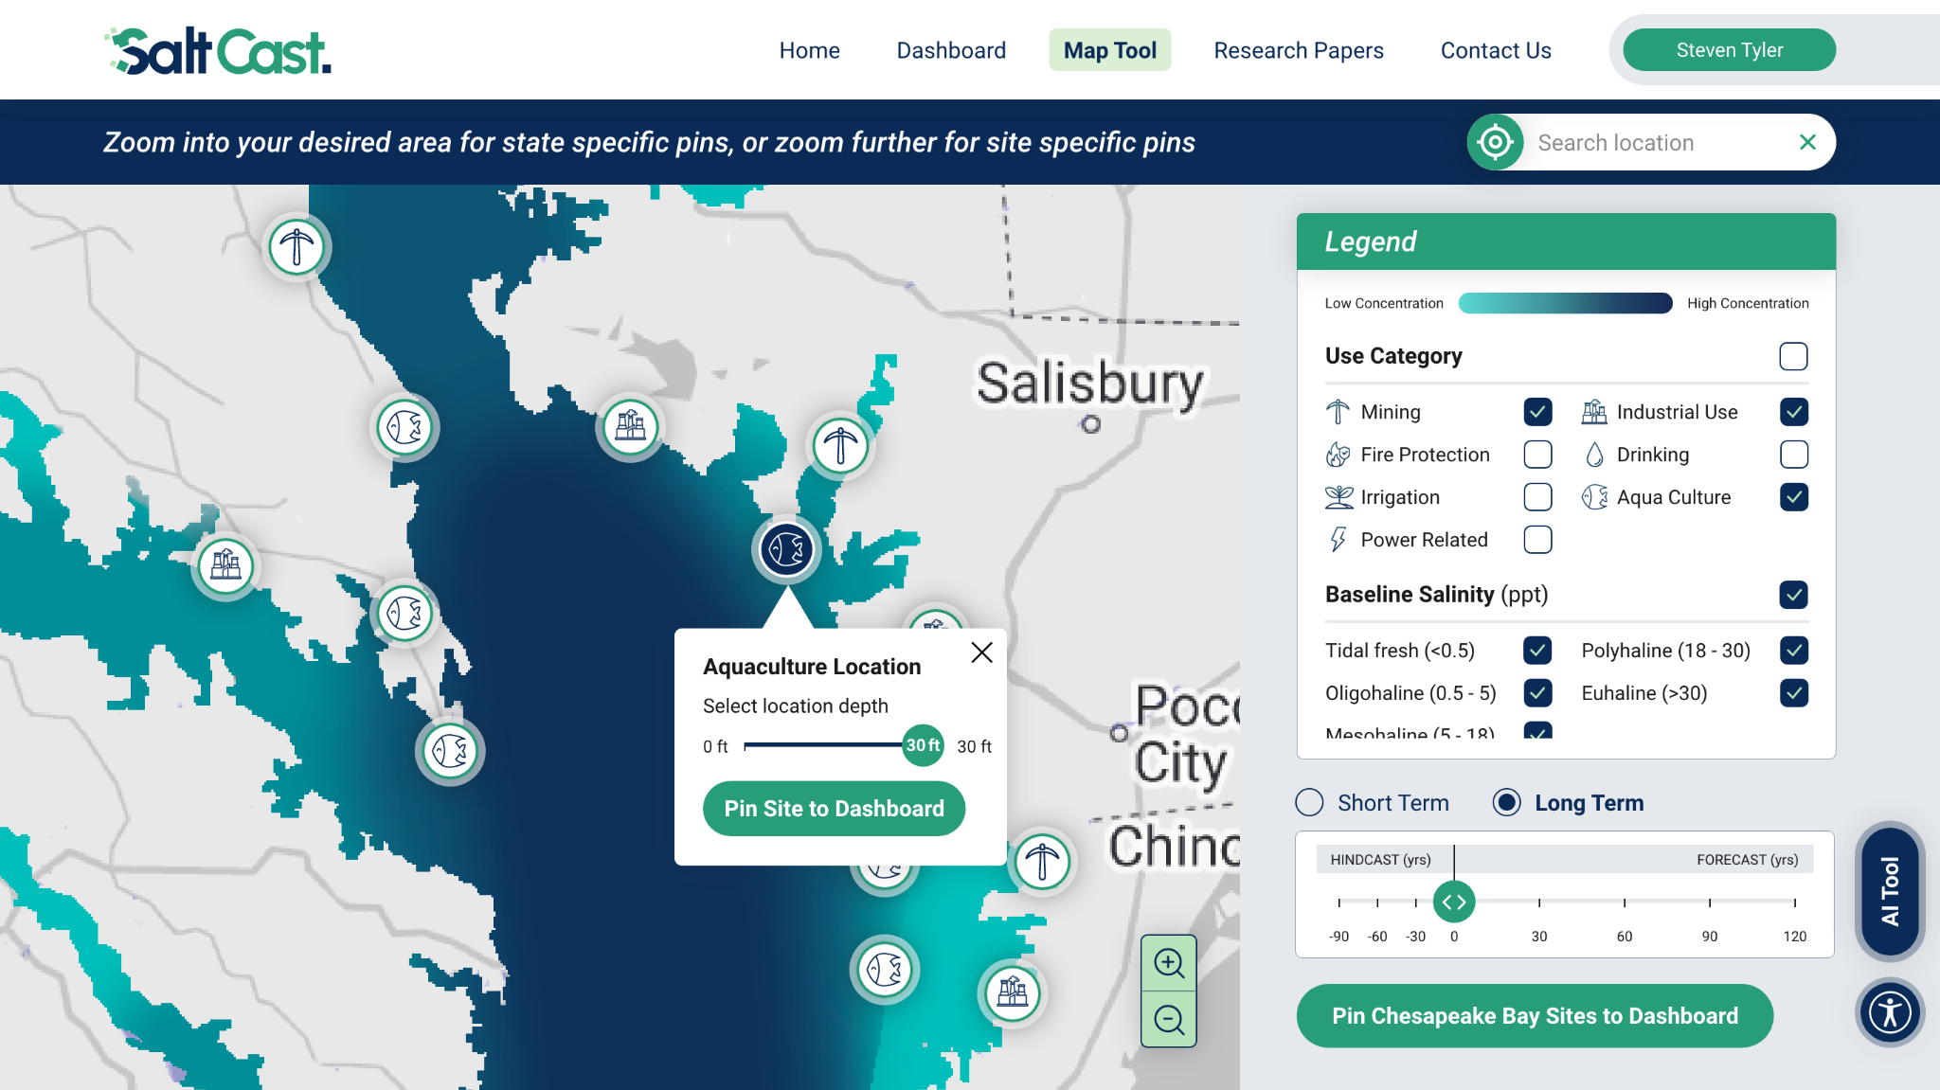

Slide 26
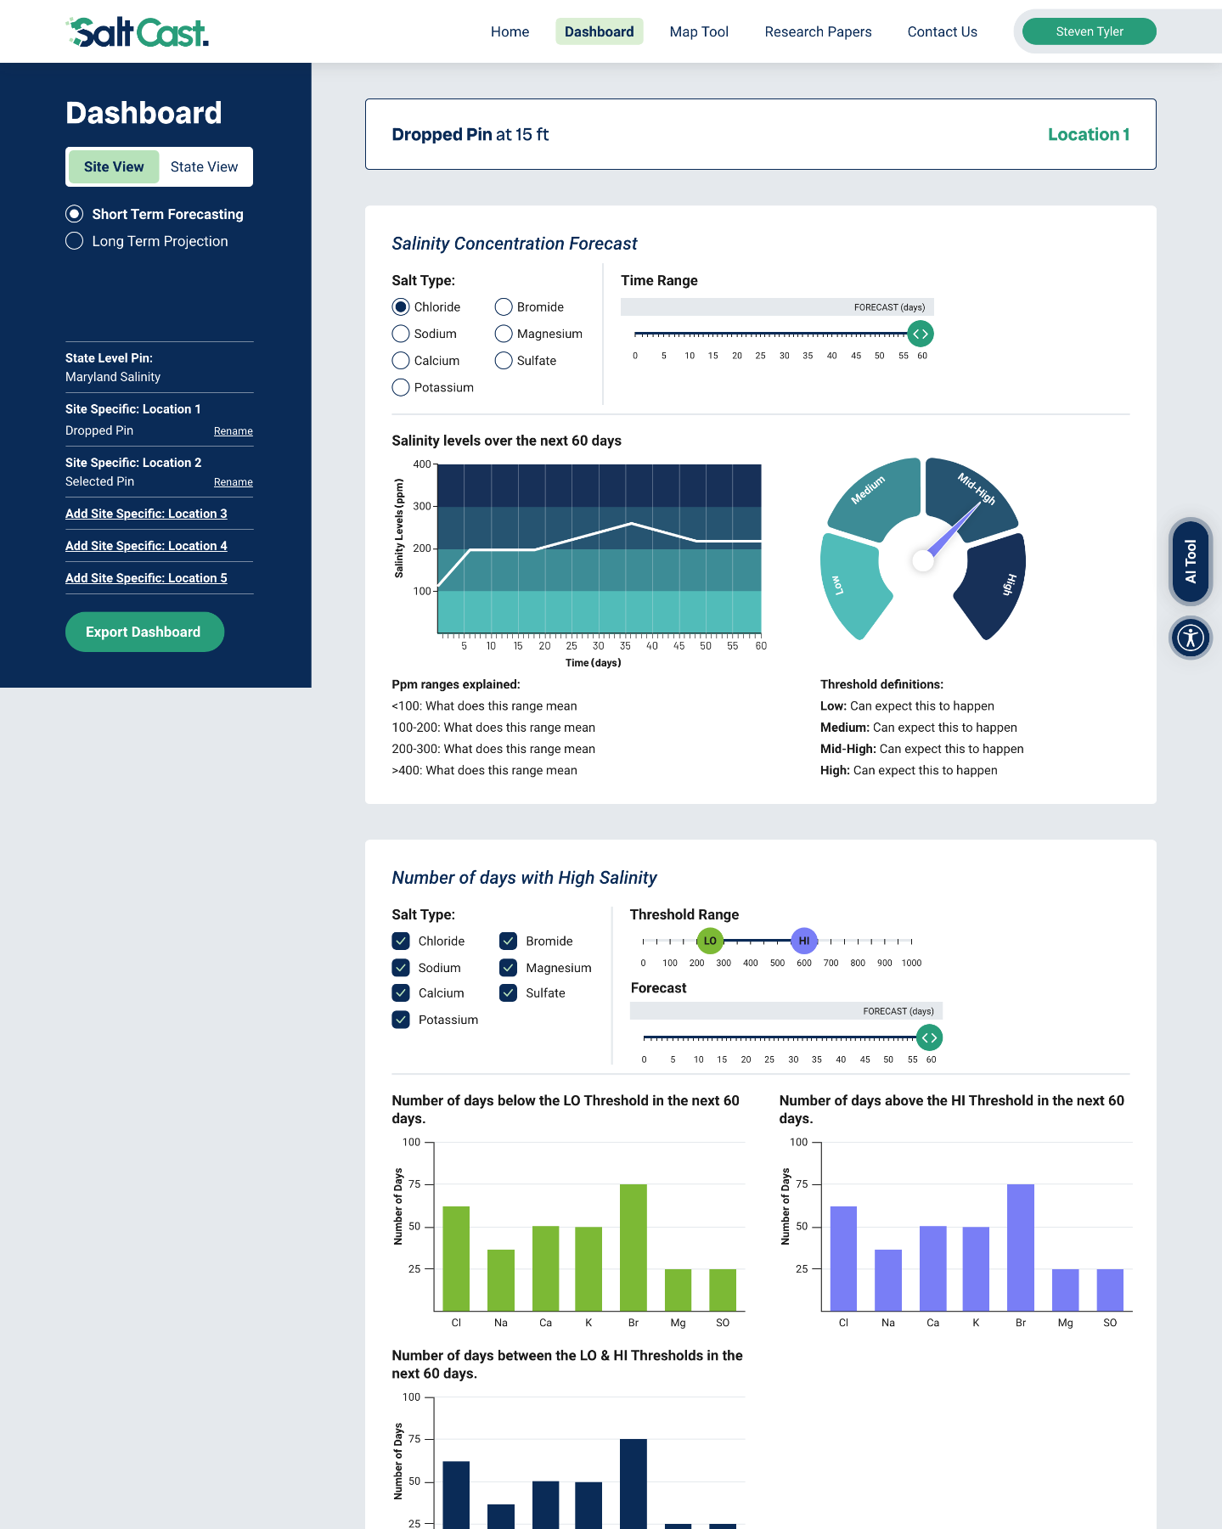

Slide 27
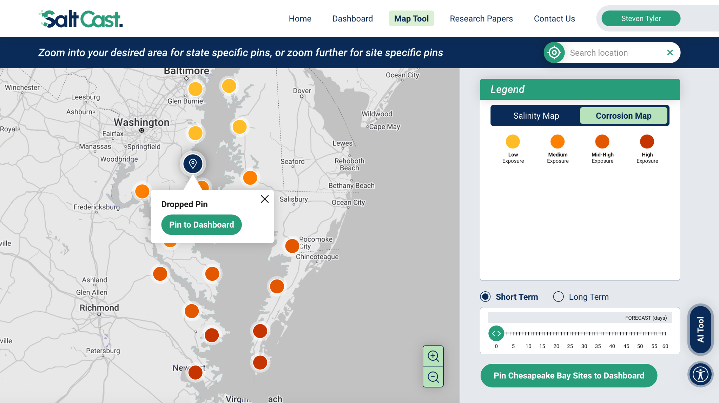

Slide 28
Phase I➡II: Adaptation Playbook + Education Campaign
Novel set of case studies on consequences of salinity exposure
Playbook of management strategies
Outreach and education campaign with related marketing materials to grow SaltCast user-base
After Phase II teams are selected, we will also work with other teams to pool resources and scale education on water quality
Notes:
Project has: the science of the watershed-estuary model, the GUI, AI-based development of adaptation strategies, an education campaign
Walter Water -- managing salt
Imelda Infrastructure -- water or land use permitting
Fred Federal

Slide 29
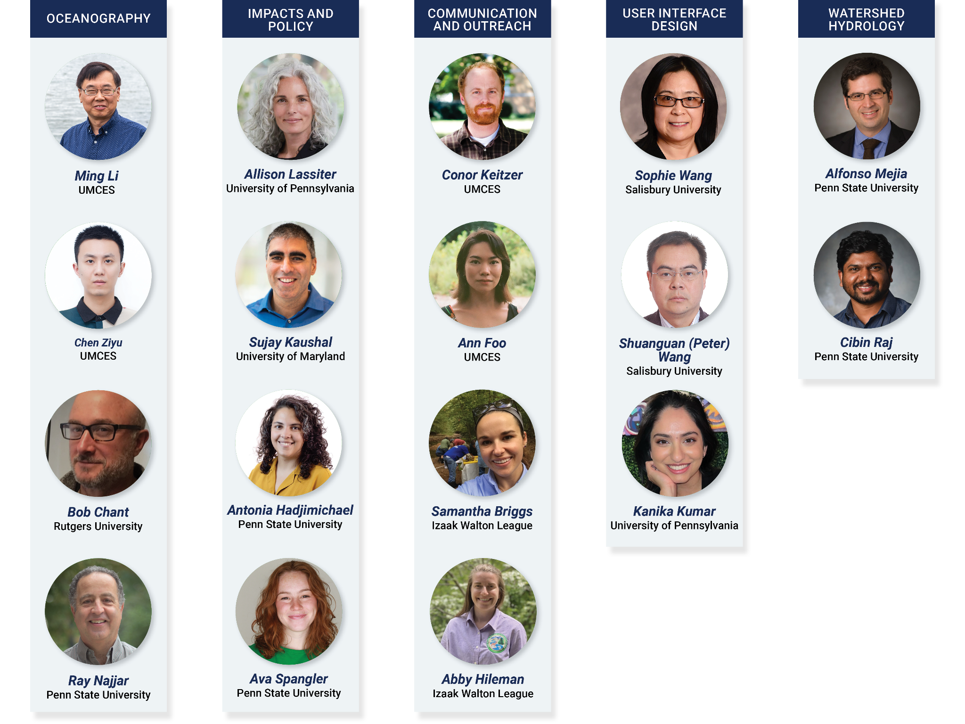
The Team
Notes:
Working on these issues for decades -- collective experience

Slide 30
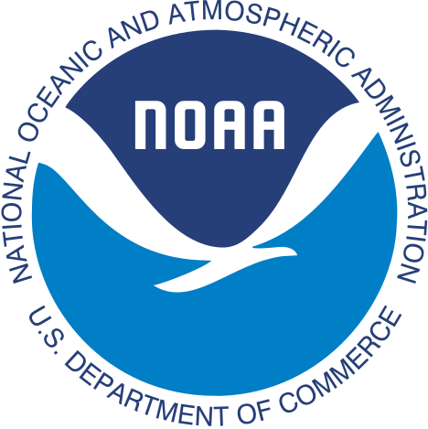



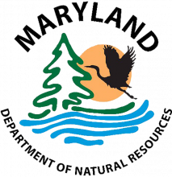


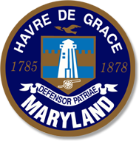
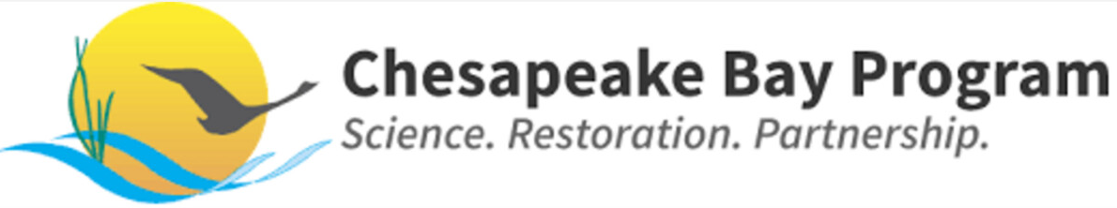

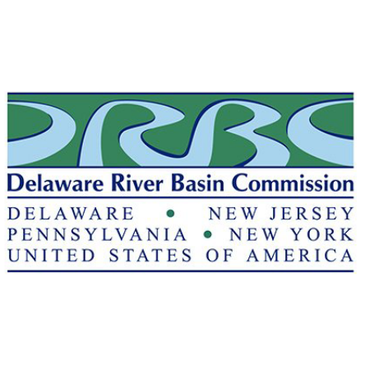

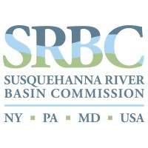
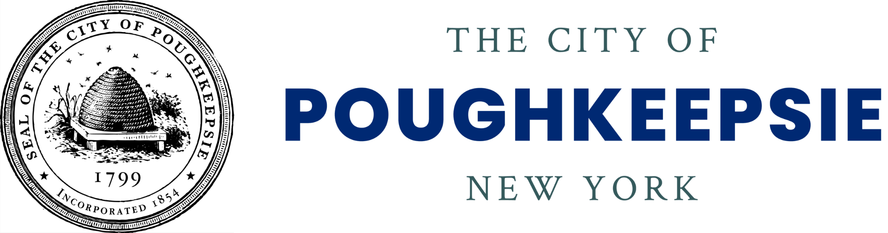

Diverse, Impactful Collaborators
Notes:
Incorporate in roadmap slide or separate, depending on if it fits. Use logos. Separate into categories. We work with this category on this thing etc. Stakeholders demand.

Slide 31
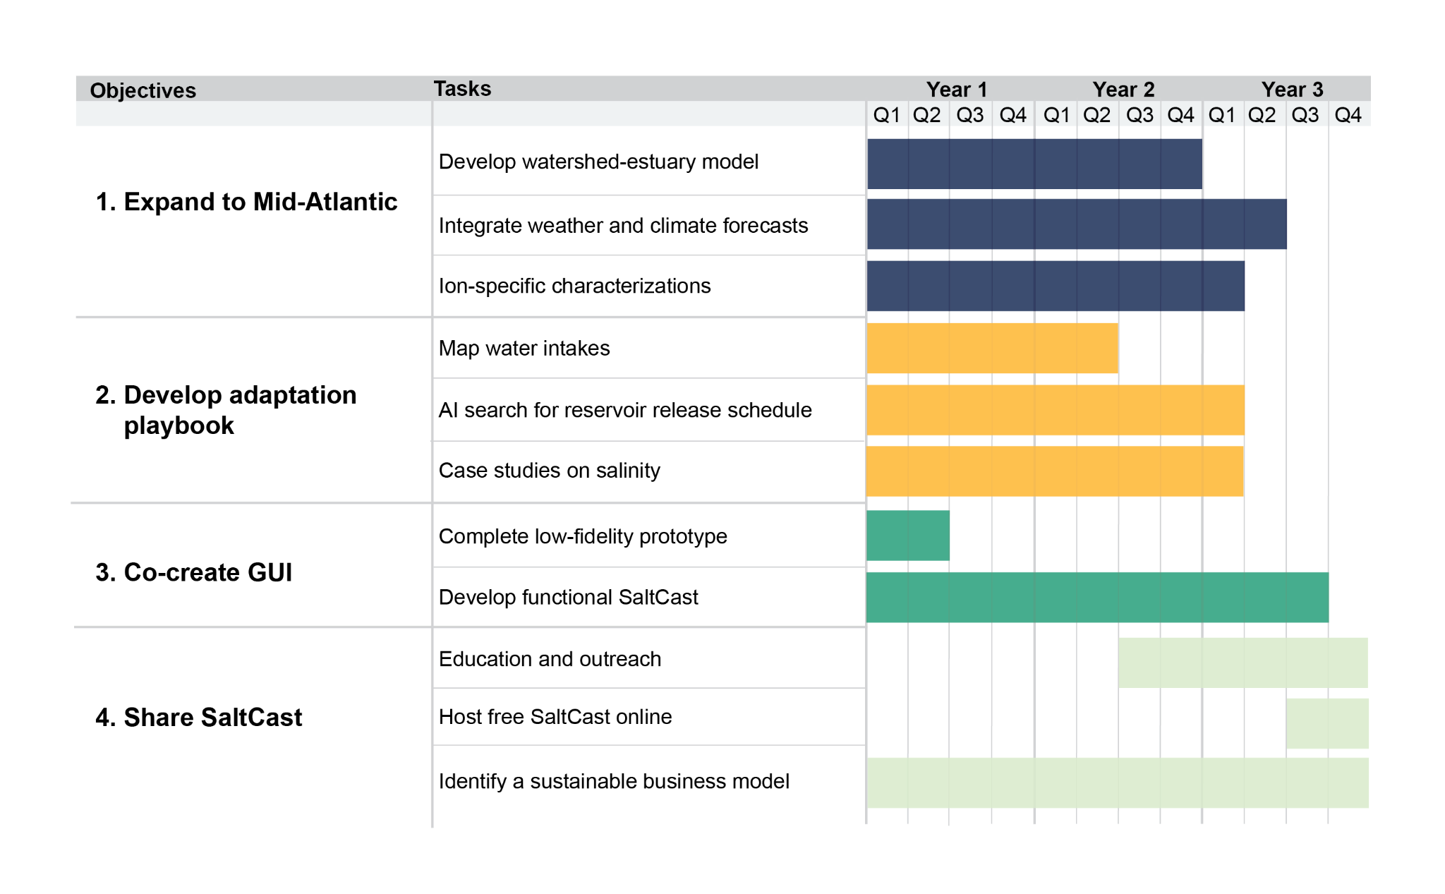
Phase II: Objectives and Plan

Slide 32
Phase II: Objectives and Plan

Slide 33
Phase II: Objectives and Plan

Slide 34
Phase II-III: Sustainable Business Model
Scale SaltCast to the U.S. with a federal partner
Initiated discussions with several federal agencies in DC
Initiated discussions with local branches of several federal agencies
Advising strategic relationship: collaborating with a inter-agency program (Chesapeake Bay Program)
Contingency plan: continue SaltCast in the Mid-Atlantic with local partners and/or philanthropy support
Notes:
Discuss how user needs led to UX/UI. Initial hypotheses and what we learned instead. But at a high level. 3-5 bullets. First we thought it was drinking water suppliers, then corrosion, now broader.
Walter Water -- managing salt
Imelda Infrastructure -- water or land use permitting
Fred Federal

Slide 35
Invest in SaltCast to Transform Salinity Management
$5 million in SaltCast over 3 years will:
Fund a cutting-edge model delivering actionable salinity information from the next week to the next century
Educate coastal water users on consequences of salinity exposure and new adaptation strategies
Minimize severe economic consequences: protect coastal freshwater security and infrastructure integrity for millions of people
Notes:
What we do and how important it is, low cost and high impact

